Slide 1
Deep Reinforcement Learning

Slide 2
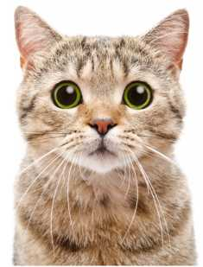
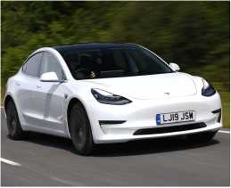
■
Supervised Learning
■ Given data: (x,y), x is data, y is label.
■ Goal: Learn a function to map x ^ y, namely posterior probability
P(Y\X = x)
cat
■ Examples: Classification, regression, object detection, face recognition, sentiment classification, etc.
car
1
SCHOOL OF INFORMATICS XIAMEN UNIVERSITY
Image source: https://www.autoexpress.co.uk/tesla/model-3
https://timesofindia.indiatimes.com/life-style/relationships/pets/5-things-that-scare-and-stress-your-cat/artideshow/67586673.cms

Slide 3
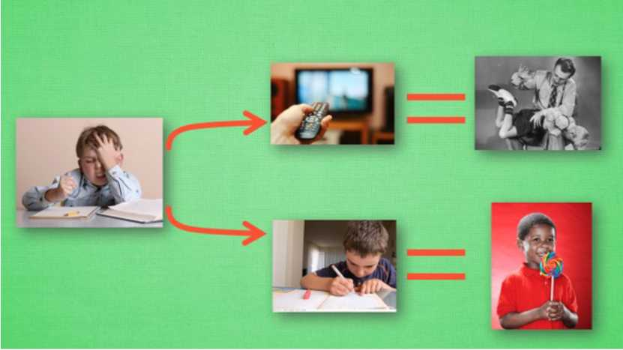
Reinforcement Learning
■ When we are kids, nobody gives us training data for good behaviors and bad behaviors.
■ We learn by trial and error with feedbacks from parents and teachers.
Negative
feedback
Positive
feedback
2
Image source: https://mofanpy.com/tutorials/machine-leaming/reinforcement-leaming/intro-q-leaming/

Slide 4
Reinforcement Learning
What makes reinforcement learning different from other machine learning paradigms?
■ There is no supervisor, only a reward signal.
■ Feedback is delayed, not instantaneous.
■ Time really matters (sequential, non i.i.d data).
■ Agent's actions affect the subsequent data it receives.
3

Slide 5
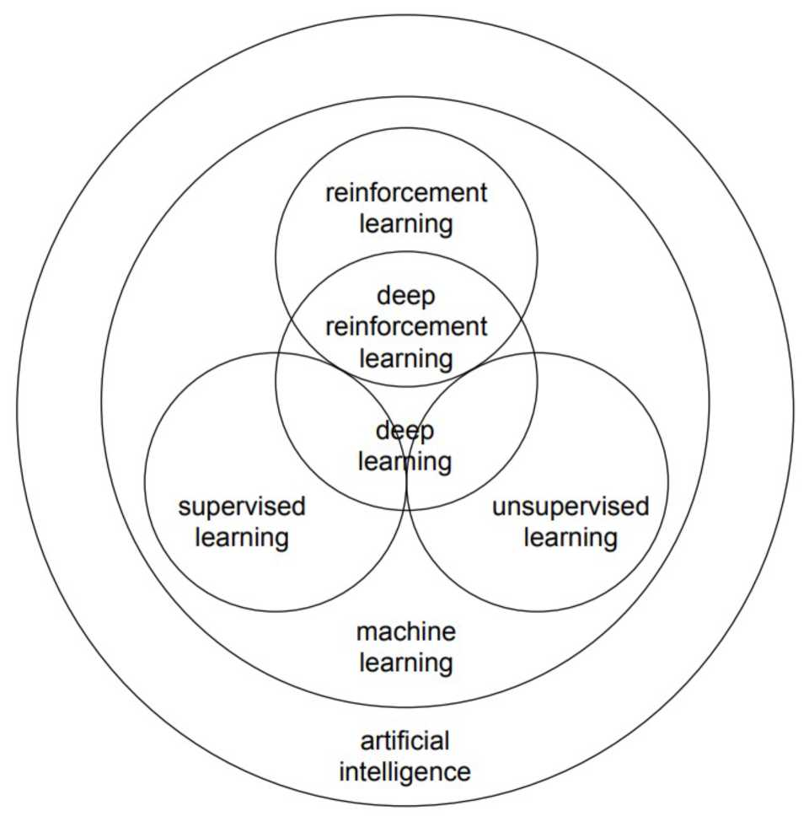
4
Image source: Li, Yuxi. "Deep reinforcement learning." arXiv preprint arXiv:1810.06339 (2018).

Slide 6
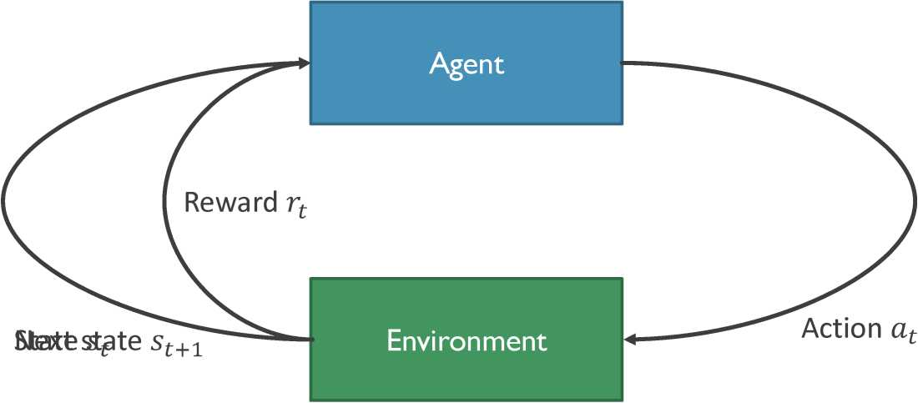
Reinforcement Learning
5

Slide 7
Reinforcement Learning
Cart-Pole Problem
■ Objective: Balance a pole on top of a movable cart.
■ State: angle, angular speed, position, horizontal velocity
■ Action: horizontal force applied on the cart.
■ Reward: 1 at each time step if the pole is upright.
1
6

Slide 8
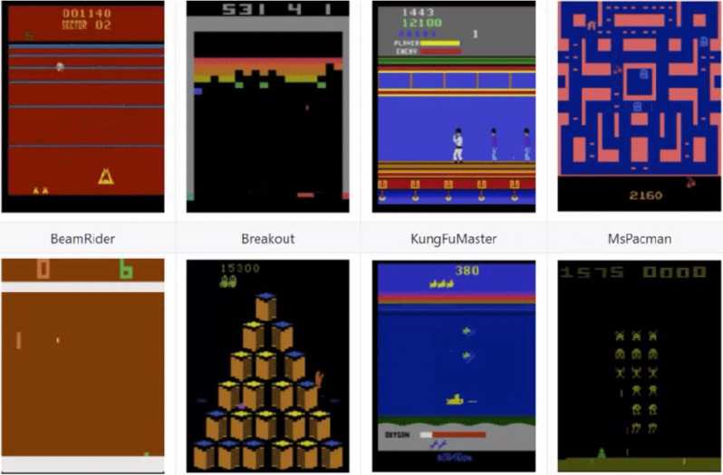
Reinforcement Learning
Atari Games
■ Objective: Complete the game with the highest score.
■ State: Raw pixel inputs of the game state.
■ Action: Game controls e.g. Left, Right, Up, Down.
■ Reward: Score increase/decrease at each time step.
7
Image source: https://syncedreview.com/2020/01/08/slm-lab-new-rl-research-benchmark-software-framework/

Slide 9
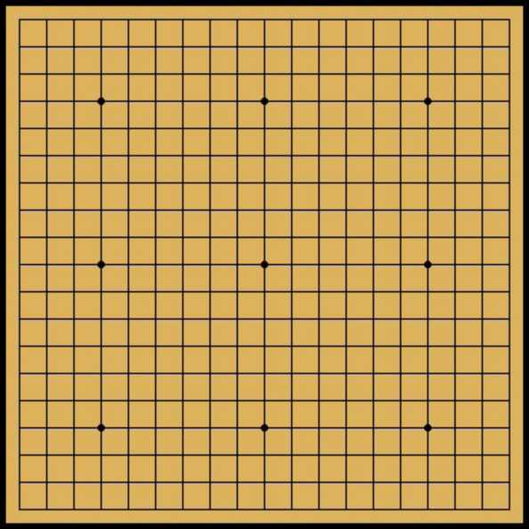
Reinforcement Learning
Go
■ Objective: Win the game.
■ State: Position of all pieces.
■ Action: Where to put the next piece down.
■ Reward: 1 if win at the end of the game, 0 otherwise.
8
Image source: https://levelup.gitconnected.com/how-deepmmds-alphago-became-the-world-s-top-go-player-5b275e553d6a?gi=766cb4dda780

Slide 10
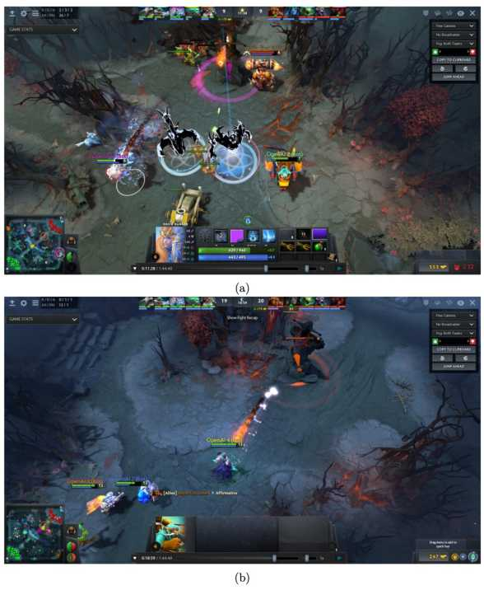
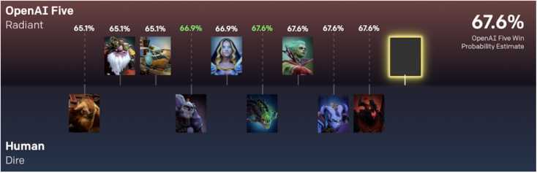
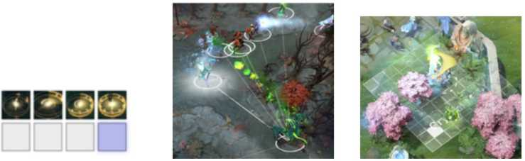
Applications of Reinforcement Learning
■ Play game
9
Image source: Berner, Christopher, Greg Brockman, Brooke Chan, Vicki Cheung, Przemystaw D^biak, Christy Dennison, David Farhi et al. "Dota 2 with large scale deep reinforcement learning." arXiv preprint arXiv:1912.06680 (2019).

Slide 11
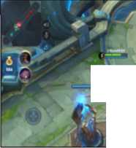
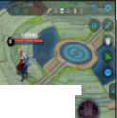




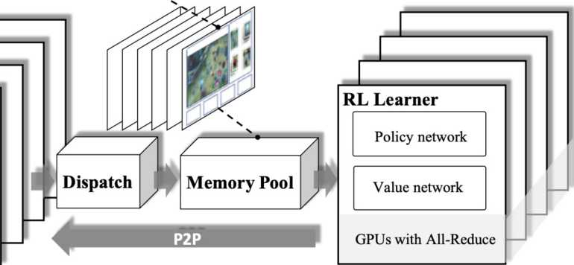
Applications of Reinforcement Learning
■
Play game
Image Feature
Unit Feature
_V*-Q *
Player’s Hero Turrets
L.^vwi:
v |  |  |  | y v ^ |  | -'
Game State |  | Action |  | Action |  | Reward -U
Info Feature |  | Mask |  | Probability
AI Server with Game Env
self-play
Agent
<—>
Env #1
<—>
Agent’
Agent
Env #n <—> Agent
10
Image source: Ye, Deheng, Zhao Liu, Mingfei Sun, Bei Shi, Peilin Zhao, Hao Wu, Hongsheng Yu et al. "Mastering Complex Control in MOBA Games with Deep Reinforcement Learning." In AAAI, pp. 6672-6679. 2020.

Slide 12
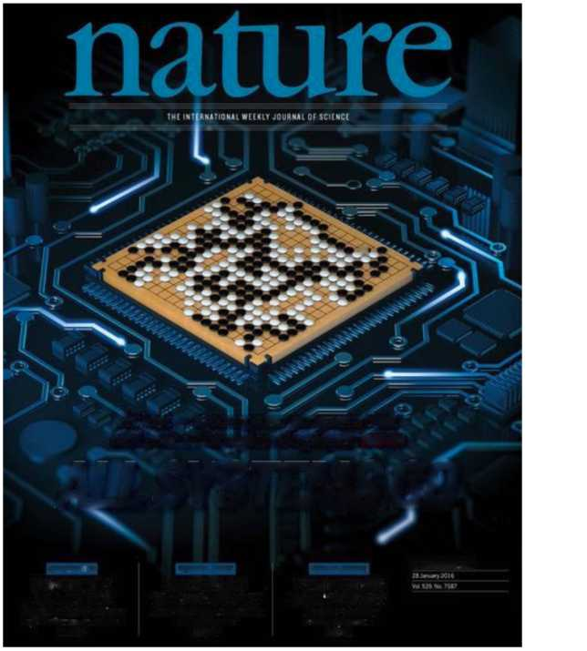
Applications of Reinforcement Learning
■ AlphaGo [DeepMind, Nature 2016]:
■ Required many engineering tricks
■ Bootstrapped from human play
■ Beat 18-time world champion Lee Sedol
■ AlphaGo Zero [Nature 2017]:
■ Simplified and elegant version of AlphaGo
■ No longer bootstrapped from human play
■ Beat (at the time) #1 world ranked Ke Jie
■ Alpha Zero (Dec. 2017)
■ Generalized to beat world champion programs on chess and shogi as well
■ MuZero (Nov. 2019)
■ Plans through a learned model of the game
 |  | m
At last — a computer program that can beat a champion Go player page 484
ALL SYSTEMS GO
cohsckutcii
MStMCH ETHICS
P0NUt$8MC
WHEN GENES GOT SELFISH’
IXm-tin.v’s culling curd 40 wws on
MCE Ml
3MTIHUSUMU
SONGBIRDS A LA CARTE
I 'IkifuJ hurwxt r>/millions »l Mt-dlTt-mmc-un Mat*
Ha at
SAFEGUARD
TRANSPARENCY
Don 'r let openness fxMi/irv »n individuals
NK434
11
Image source: https://becominghuman.ai/summary-of-the-alphago-paper-b55ce24d8a7c

Slide 13
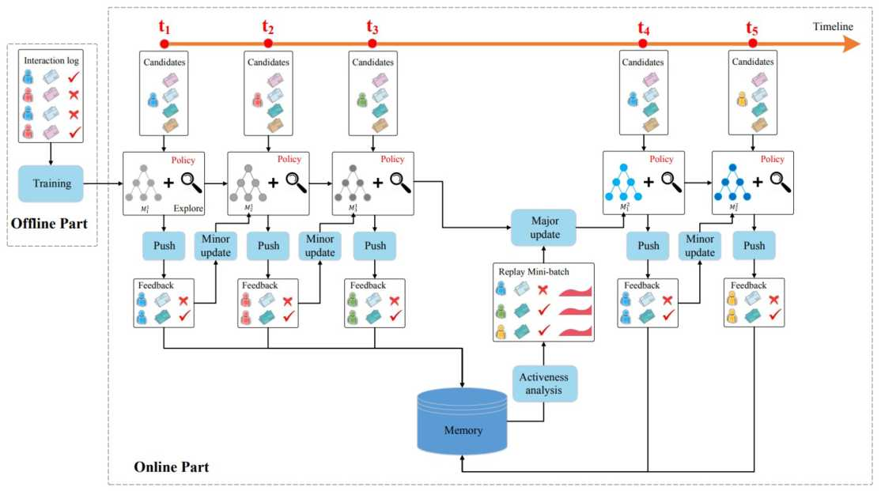
Applications of Reinforcement Learning
■ Recommander system
12
Image source: Zheng, Guanjie, Fuzheng Zhang, Zihan Zheng, Yang Xiang, Nicholas Jing Yuan, Xing Xie, and Zhenhui Li. "DRN: A deep reinforcement learning framework for news recommendation." In Proceedings of the 2018 World Wide Web Conference, pp. 167-176. 2018.

Slide 14
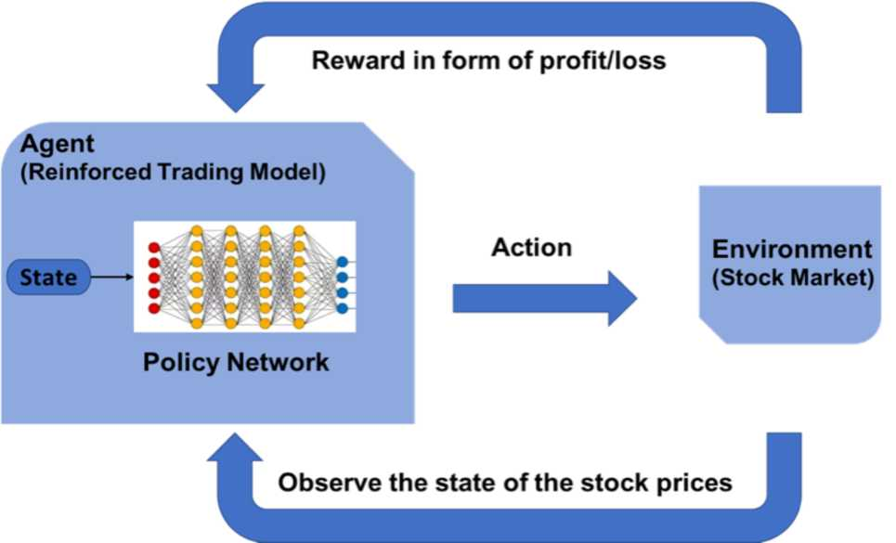
Applications of Reinforcement Learning
■ Financial trading
13
Image source: https://medium.com/inside-machine-leaming/reinforcement-leaming-the-business-use-case-part-2-c175740999

Slide 15
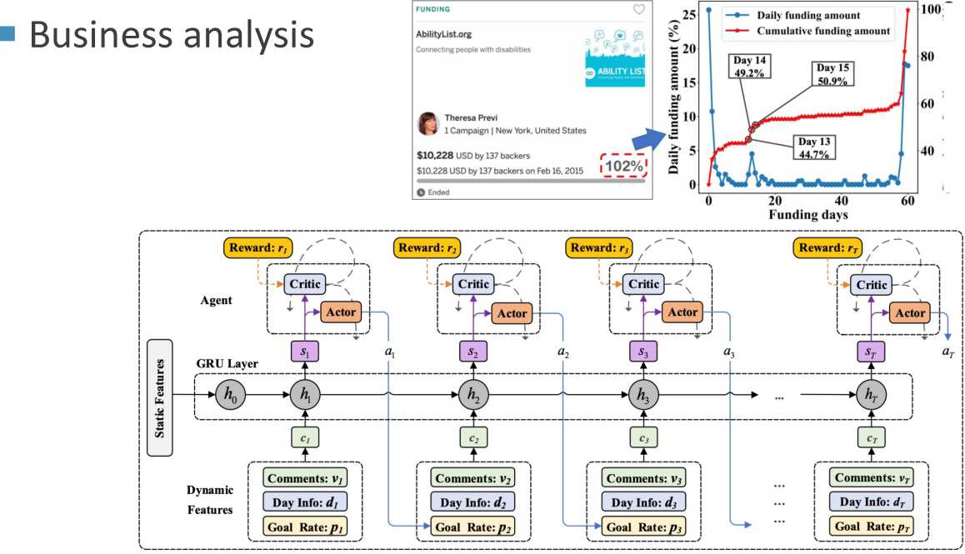
Applications of Reinforcement Learning
Cumulative funding amount (%)
Crowdfunding dynamics tracking
14
Image source: Wang, Jun, Hefu Zhang, Qi Liu, Zhen Pan, and HanqingTao. "Crowdfunding Dynamics Tracking: A Reinforcement Learning Approach." In AAAI, pp. 6210-6218. 2020.

Slide 16
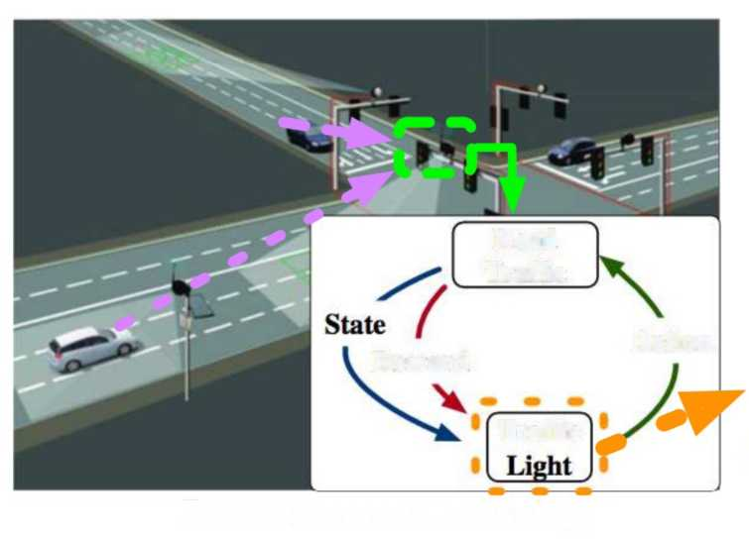
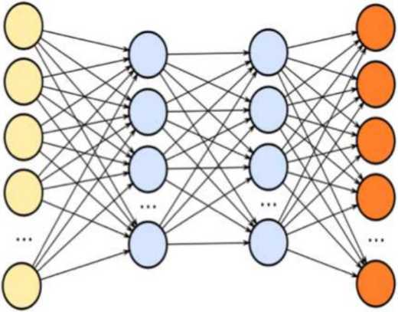
Applications of Reinforcement Learning
■ Smart transportation
Input:
Output:
States
Actions
Road
Traffic
Reward
Action
Traffic
Reinforcement Learning
Deep Learning
Traffic light control model
15
Image source: Liang, Xiaoyuan, Xunsheng Du, Guiling Wang, and Zhu Han. "Deep reinforcement learning for traffic light control in vehicular networks." arXiv preprint arXiv:1803.11115 (2018).

Slide 17
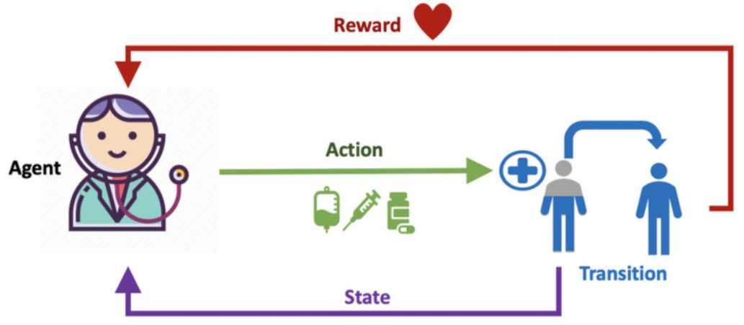
Applications of Reinforcement Learning
■ Healthcare
16
Image source: Liu, Siqi, Kay Choong See, Kee Yuan Ngiam, Leo Anthony Celi, Xingzhi Sun, and Mengling Feng. "Reinforcement learning for clinical decision support in critical care: comprehensive review." Journal of medical Internet research 22, no. 7 (2020): e18477.

Slide 18
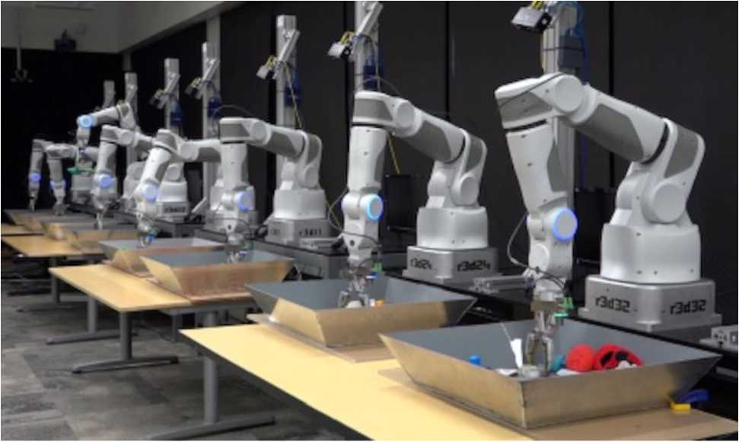
Applications of Reinforcement Learning
■ Robotics
17
Image source: https://blogs.sw.siemens.com/tecnomatix/part-2-how-digital-twins-help-scale-up-industrial-robotics-ai/

Slide 19
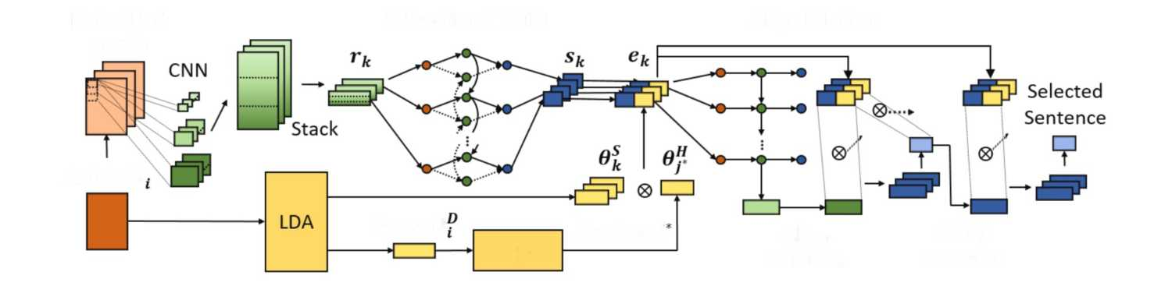
Applications of Reinforcement Learning
■ NLP
Embedded
Article
Bidirectional LSTM
Align Relation
Article D
Query 6
Retrieve j
Align
Relation
2-Hop
Attention
Corpus
18
Image source: Song, Yun-Zhu, Hong-Han Shuai, Sung-Lin Yeh, Yi-Lun Wu, Lun-Wei Ku, and Wen-Chih Peng. "Attractive or Faithful? Popularity-Reinforced Learning for Inspired Headline Generation." arXiv preprint arXiv:2002.02095 (2020).

Slide 20
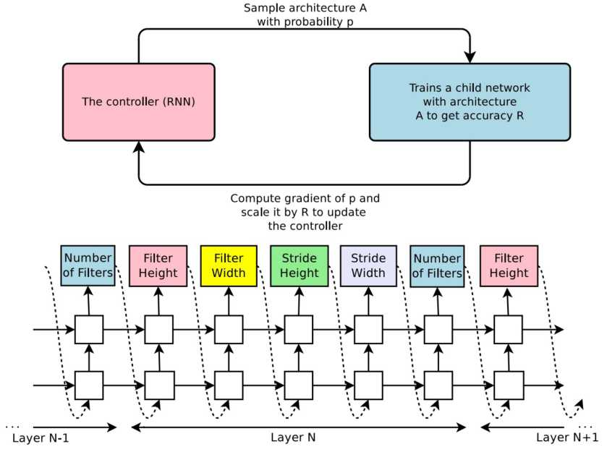
Applications of Reinforcement Learning
■ Network architecture search
19
Image source: Zoph, Barret, and Quoc V. Le. "Neural architecture search with reinforcement learning." arXiv preprint arXiv:1611.01578 (2016).

Slide 21
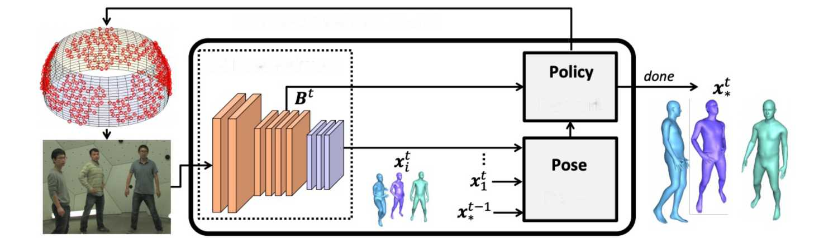
Applications of Reinforcement Learning
■ CV
next viewpoint selection (0_{a}, 6_{e})
3d Pose Network
Network
Fusion
Active human pose estimation
20
Image source: Gartner, Erik, Aleksis Pirinen, and Cristian Sminchisescu. "Deep Reinforcement Learning for Active Human Pose Estimation." In AAAI, pp. 10835-10844. 2020.

Slide 22
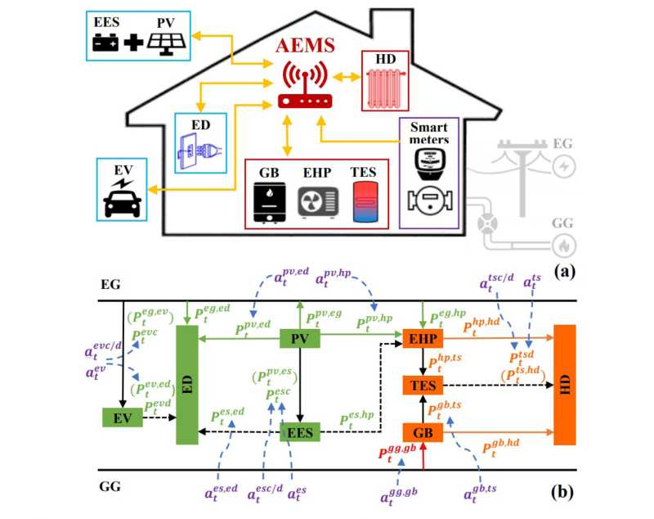
Applications of Reinforcement Learning
■ Energy management
21
Image source: Ye, Yujian, Dawei Qiu, Jonathan Ward, and Marcin Abram. "Model-Free Real-Time Autonomous Energy Management for a Residential Multi-Carrier Energy System: A Deep Reinforcement Learning Approach." IJCAI, 2020.

Slide 23
■ Markov Decision Process
■ Q-Learning
■ Deep Q Network
■ Policy Gradient
■ Actor-Critic
22

Slide 24
Reinforcement Learning vs Human
There are several differences or similarities between humans and reinforcement learning to play games:
■ RL does not accept any rule input, and guesses the game rule through trial and error completely. From this perspective, RL will be much better than humans.
■ E.g. RL will not be influenced by shuffled pixels.
■ Humans have a lot of prior knowledge. However, RL doesn't know anything, it's all by trial and error.
■ E.g. the ball will bounce, the popping angle is the same as the popping angle, the actions correspond to the movement of the racket, and so on.
75

Slide 25
Reinforcement Learning vs Human
There are several differences or similarities between humans and reinforcement learning to play games:
■ Trial and error is a necessary condition for RL learning, but not a necessary condition for human learning.
■ E.g., humans don't need to experience car crashes hundreds of times in order to learn how to avoid car crashes.
■ Prior knowledge determines that humans can quickly abstract the rules of the game (strategic network).
■ E.g., describe the rules of the game in one sentence.
76

